Slide 1
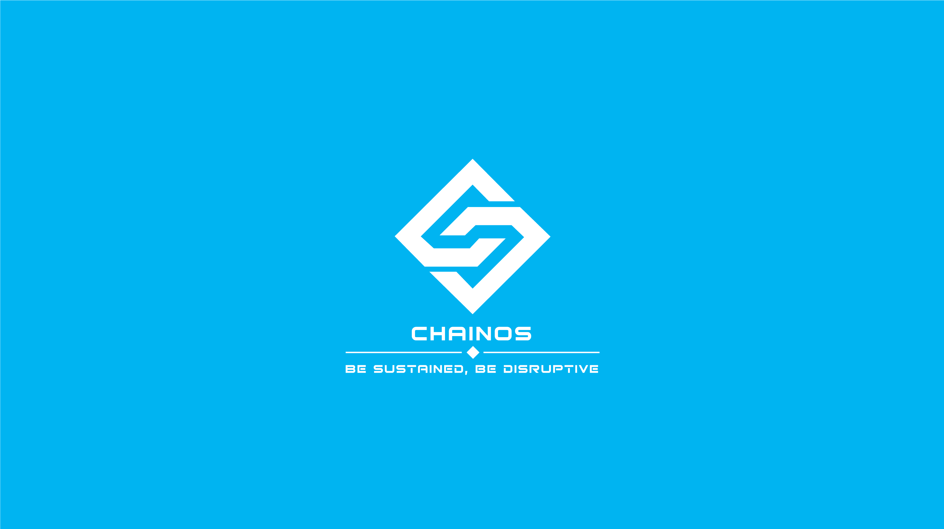

Slide 2

BLOCKCHAIN P1. OVERVIEW & DEFINITIONS
Chainos Solution
2019/03/19

Slide 3
CHAINOS SOLUTION JSC
Blockchain technology
AGENDA
What is Blockchain?
Problems solved by the blockchain
How it work?
Why does it secure?
Advantages and disadvantages
Applications
Other definitions
Discussion

Slide 4
CHAINOS SOLUTION JSC
Blockchain technology
What is blockchain?
A blockchain is a distributed database that maintains a continuously-growing list of records called blocks secured from tampering and revision.
– Wikipedia definition –
A smart contract is a computer protocol intended to digitally facilitate, verify, or enforce the negotiation or performance of a contract. Smart contracts allow the performance of credible transactions without third parties. These transactions are trackable and irreversible.
– Wikipedia definition –
* Currently we have Blockchain 1.0 and Blockchain 2.0, while Blockchain 3.0 is under development.

Slide 5

CHAINOS SOLUTION JSC
Blockchain technology
Problems solved by the blockchain
Basically, Blockchain technology can solves belief problem.
Manage physical assets (land, certificates)
Verify original data, copyright problems
Share verifiable data
Things traceability (food, drug, containers, …)
Transparence in money usage (charity fund, …)
Transparence in government activities
…

Slide 6
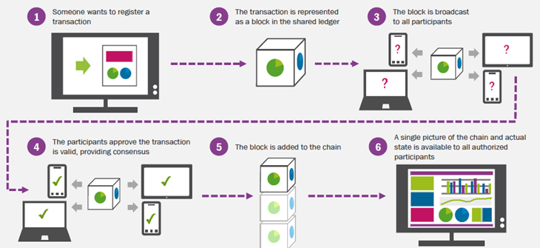
CHAINOS SOLUTION JSC
Blockchain technology
How it work?

Slide 7

CHAINOS SOLUTION JSC
Blockchain technology
Why does it secure?
Blockchain is a distributed ledger
Each block has an unique cryptographic fingerprint
Network with a consensus protocol

Slide 8
CHAINOS SOLUTION JSC
Blockchain technology
4.1. Distributed ledger
An P2P network
Every node has a copy of main chain (ledger)
Centralized
P2P network

Slide 9
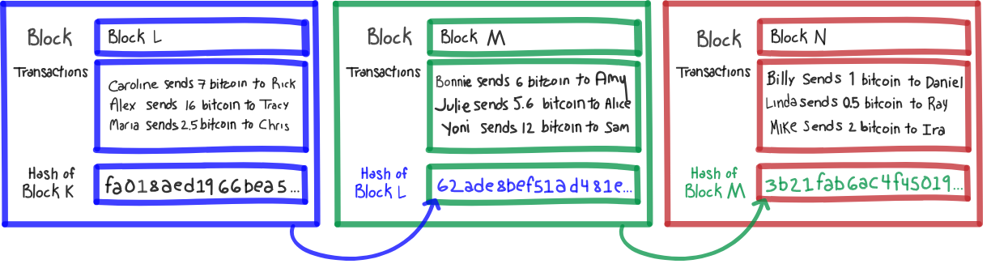
CHAINOS SOLUTION JSC
Blockchain technology
4.2. Cryptographic fingerprint
Each block has a cryptographic fingerprint (hash)
Each block contains the previous block’s hash

Slide 10
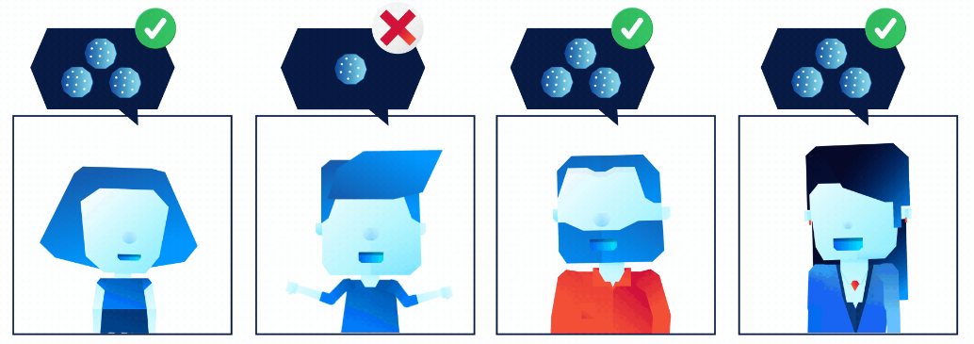
CHAINOS SOLUTION JSC
Blockchain technology
4.3. Network consensus protocol
Every nodes follow the same consensus
Consensus keep the network has the only one ledger

Slide 11

CHAINOS SOLUTION JSC
Blockchain technology
Advantages and disadvantages
5.1. Advantages
Greater transparency
Enhanced security
Improved traceability
Increased efficiency and speed
Reduced costs

Slide 12

CHAINOS SOLUTION JSC
Blockchain technology
Advantages and disadvantages
5.2. Disadvantages
Bad performance
Wasteful
Unchangeable

Slide 13
CHAINOS SOLUTION JSC
Blockchain technology
Applications

Slide 14
CHAINOS SOLUTION JSC
Blockchain technology
Other definitions
Hash
Public-key cryptography

Slide 15
CHAINOS SOLUTION JSC
Blockchain technology
Other definitions
Transaction
Block, genesis block
Reward, fee

Slide 16
CHAINOS SOLUTION JSC
Blockchain technology
Other definitions
Confirmations

Slide 17
CHAINOS SOLUTION JSC
Blockchain technology
Other definitions
Mining

Slide 18
CHAINOS SOLUTION JSC
Blockchain technology
Other definitions
Block time
Difficulty

Slide 19
CHAINOS SOLUTION JSC
Blockchain technology
Other definitions
Consensus

Slide 20
CHAINOS SOLUTION JSC
Blockchain technology
Other definitions
Address
Wallet

Slide 21
CHAINOS SOLUTION JSC
Blockchain technology
Discussion

Slide 22

CHAINOS SOLUTION JSC

